Slide 1
Lecture 3-4 SATELLITE SYSTEMS
Reference
“INTRODUCTION TO WIRELESS AND MOBILE SYSTEMS”, DHARMA ARAWAL

Slide 2
Contents
1. Introduction to satellite systems
2. Characteristics of satellite systems
3. Elements of wireless systems
4. Cellular network
5. Wireless mesh networks

Slide 3
Introduction to satellite systems
History of mobile communication
Please refer to Tables 1.1 - 1.6, pp. 2-10
Challenges were faced:
Growing number of users
Covered area (cell size)
Mobility
QoS
Cost

Slide 4
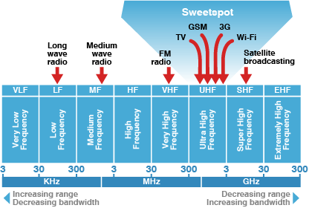

Slide 5
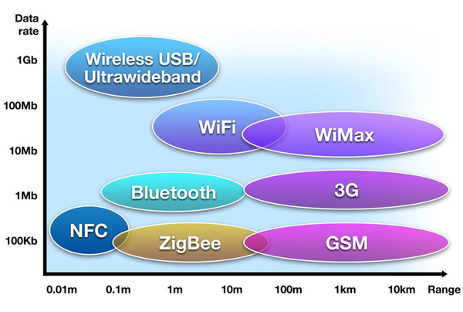

Slide 6
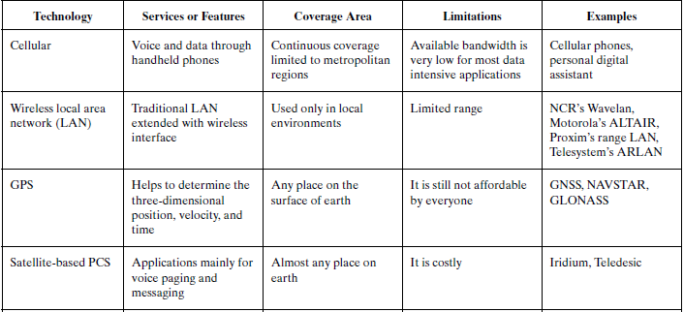

Slide 7
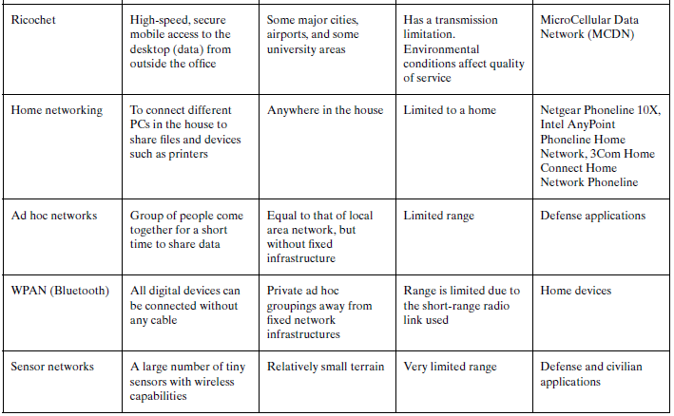

Slide 8
2-Characteristics of satellite systems
Wireless systems had a high-power transmitter covering the entire service area.
Different wireless devices need to be supported for different types of services; telephone, PDA, laptop (mobile subscriber)
It has to maintain connectivity with the world
while moving.

Slide 9
Elements of a wireless network
wireless hosts
laptop, PDA, IP phone
run applications
may be stationary (non-mobile) or mobile
wireless does not always mean mobility
network
infrastructure

Slide 10
Elements of a wireless network
base station
typically connected to wired network
relay - responsible for sending packets between wired network and wireless host(s) in its “area”
e.g., cell towers, 802.11 access points
network
infrastructure

Slide 11
Elements of a wireless network
wireless link
typically used to connect mobile(s) to base station
also used as backbone link
multiple access protocol coordinates link access
various data rates, transmission distance
network
infrastructure

Slide 12
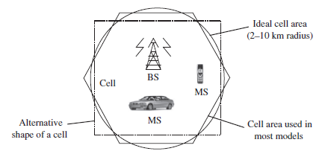
continued
Cell basically represents the area that can be covered by a transmitting station, usually called a base station (BS).
radius of the cell is equal to the reachable range of the transmitted signal.
Each cell serves
multiple Mobile Subscribers
(MS) by connecting them
to single BS

Slide 13
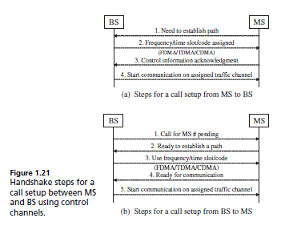

Slide 14
continued
Base station controllers (BSCs) which connect BS’s via wire
Mobile switching center (MSC) are connected to a MSCs are connected to the telephone network

Slide 15
continued
mobile switching center (MSC) :
Is responsible for routing calls, SMS, and data
Contains three components:
Home Location Register (HLR)
Initial home location of MS where billing and access information are maintained
Visitor Location Register (VLR)
Information about visiting MSs
Authentication Center (AuC)
Authentication information of MS SIM card
Each MS subscribes to only one MSC

Slide 16
continued
the MS needs to be in the area of one of the cells (and hence a BS) so that mobility of the MS can be supported.
BSs are connected through hard-wires and are controlled by a BS controller (BSC).
which in turn is connected to a mobile switching center (MSC).
Several MSCs are interconnected to a PSTN (public switched telephone network) and the
ATM (asynchronous transfer mode) backbone.

Slide 17
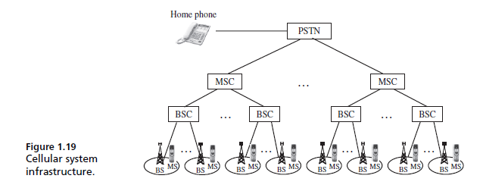

Slide 18
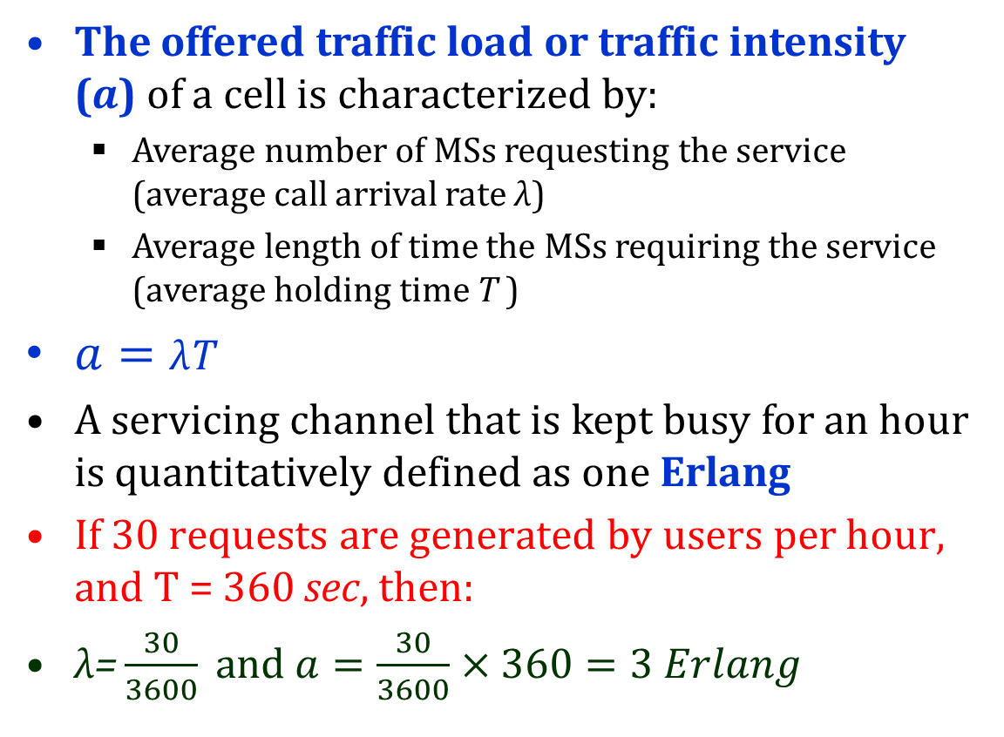
Cell Capacity
The offered traffic load or traffic intensity ($a$) of a cell is characterized by:
Average number of MSs requesting the service (average call arrival rate λ)
Average length of time the MSs requiring the service (average holding time T )
$a=\text{λ}\text{T}$
A servicing channel that is kept busy for an hour is quantitatively defined as one Erlang
If 30 requests are generated by users per hour, and T = 360 sec, then:
$\text{λ}\text{=}\frac{30}{3600} and a=\frac{30}{3600}×360=3 Erlang$

Slide 19
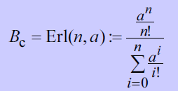
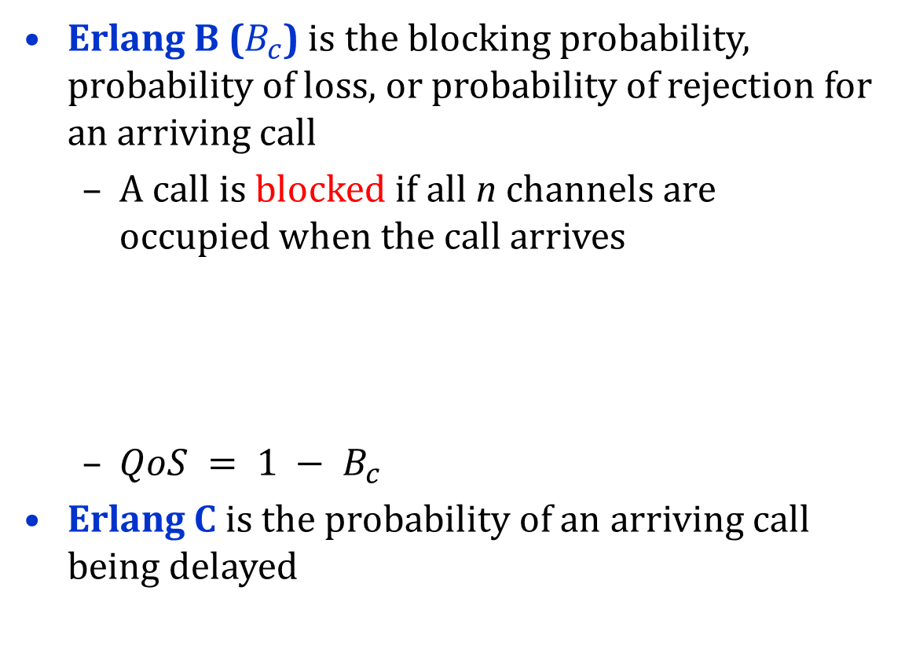
Cell Capacity
Erlang B ($B_{c}$) is the blocking probability, probability of loss, or probability of rejection for an arriving call
A call is blocked if all n channels are occupied when the call arrives
$QoS = 1 − B_{c}$
Erlang C is the probability of an arriving call being delayed

Slide 20
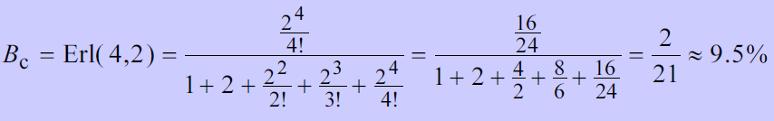
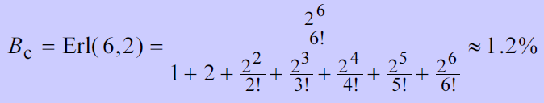

Cell Capacity
Capacity (n) is the number of channels required for the cell based on its traffic load and a given blocking probability
$n(a) = min⁡\{i =1,2, | Erl(i,a) < B_{C_{max}}\}$
Assume that the the offered traffic is $a = 2.0 Erlang$, and the blocking probability is 1%
$n(2.0) = min⁡\{i =1,2, | Erl(i,2.0) <0.01\}$

Slide 21
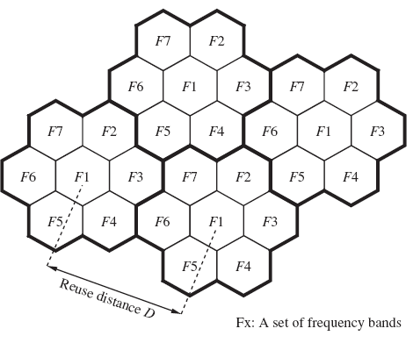
Frequency Reuse
A frequency band or channel in a cell can be reused in another cell if those cells are apart and there would be no interference

Slide 22
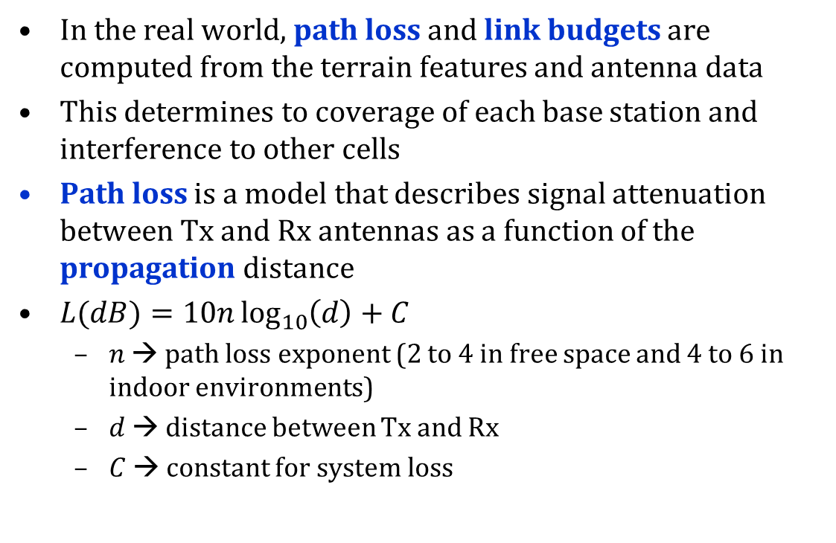
Frequency Reuse
In the real world, path loss and link budgets are computed from the terrain features and antenna data
This determines to coverage of each base station and interference to other cells
Path loss is a model that describes signal attenuation between Tx and Rx antennas as a function of the propagation distance
$L(dB)=10n\log_{10}\left(d\right)+C$
$n$ → path loss exponent (2 to 4 in free space and 4 to 6 in indoor environments)
$d$ → distance between Tx and Rx
$C$ → constant for system loss

Slide 23
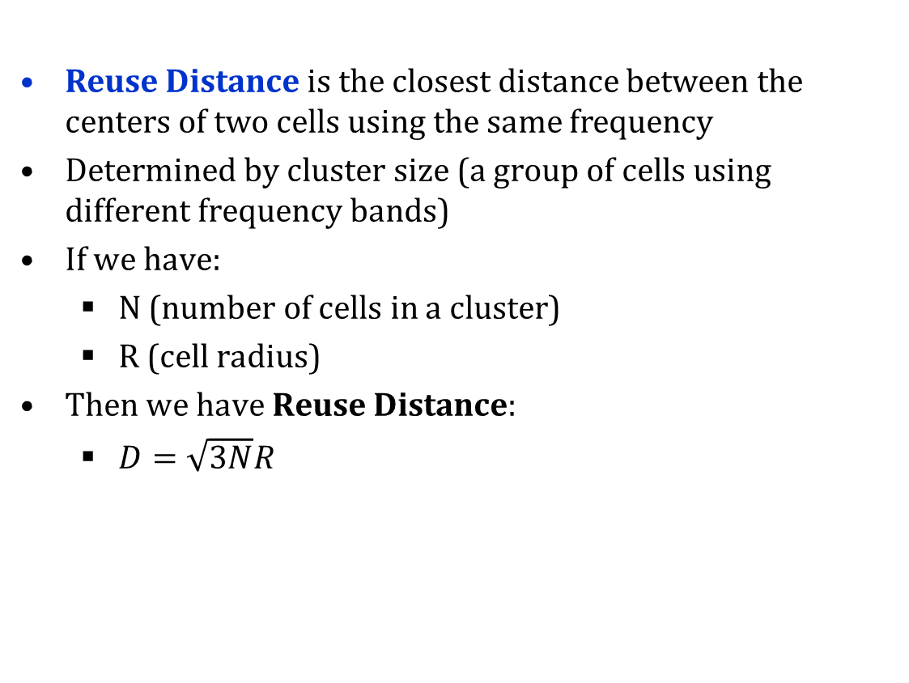
Reuse Distance
Reuse Distance is the closest distance between the centers of two cells using the same frequency
Determined by cluster size (a group of cells using different frequency bands)
If we have:
N (number of cells in a cluster)
R (cell radius)
Then we have Reuse Distance:
$D=\sqrt{3N}R$

Slide 24
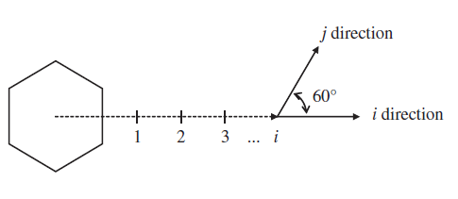

Reuse Distance
Cluster size N is usually set to 1, 3, 4, 7, 9, …
$N=i^{2}+ij+j^{2}$
$i$ is number of cells in along direction
$j$ is number of cells in direction ${60}^{o}$ to direction of $i$

Slide 25
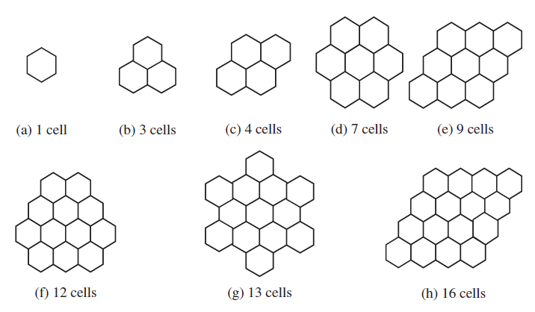
Reuse Distance

Slide 26
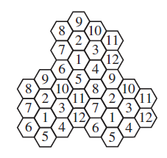
Frequency Reuse Example
In the figure below, find the reuse distance if the radius of each cell is 2 km
If each channel is multiplexed among 8 users, how many calls can be simultaneously processed by each cell if only 10 channels per cell are reserved for control, assuming a total bandwidth of 30MHz is available and each simplex channel consists of 25 kHz?

Slide 27
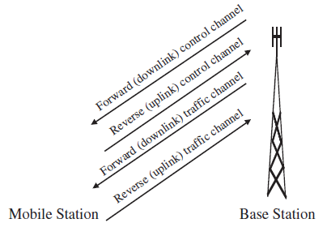
A Note on Signaling
Control Plane
Used to control bearer traffic (authentication, subscriber info, call parameter negotiations)
Data (User) Plane
Used for subscriber traffic (voice & data)

Slide 28
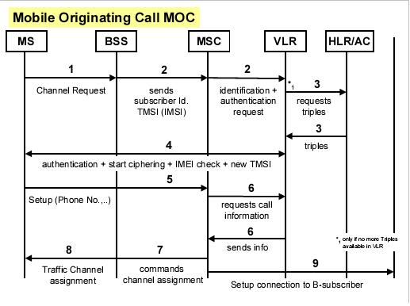
A Typical Call Setup

Slide 29
A Typical Call Setup
Validate information of subscriber originating the call (authentication)
Find the cell where the receiver is currently located (location management)
Allocate downlink and uplink channels (resource management)
Maintain the call if receiver moves while call is active (handoff/admission control)
Channels used are either control or data, and either uplink (MS → BS) or downlink (BS → MS)

Slide 30
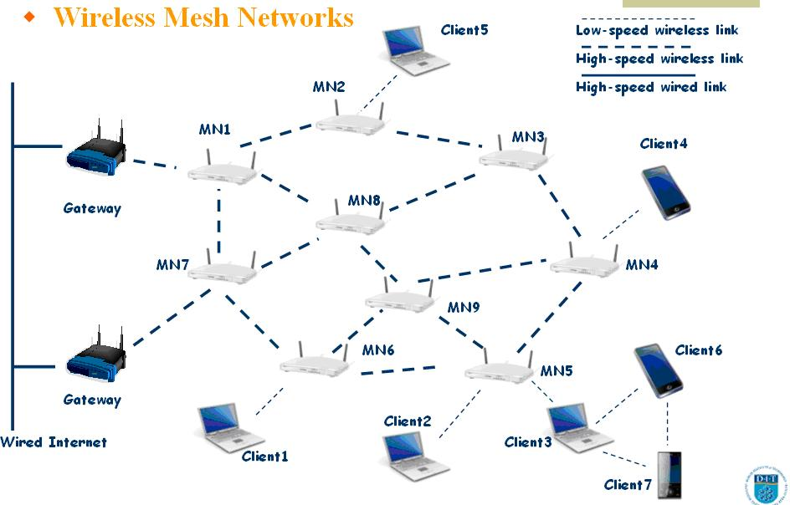
5. Wireless mesh networks

Slide 31
Thanks- Questions !

